Slide 1
Housing Options Worker
Simon Okely

Slide 2
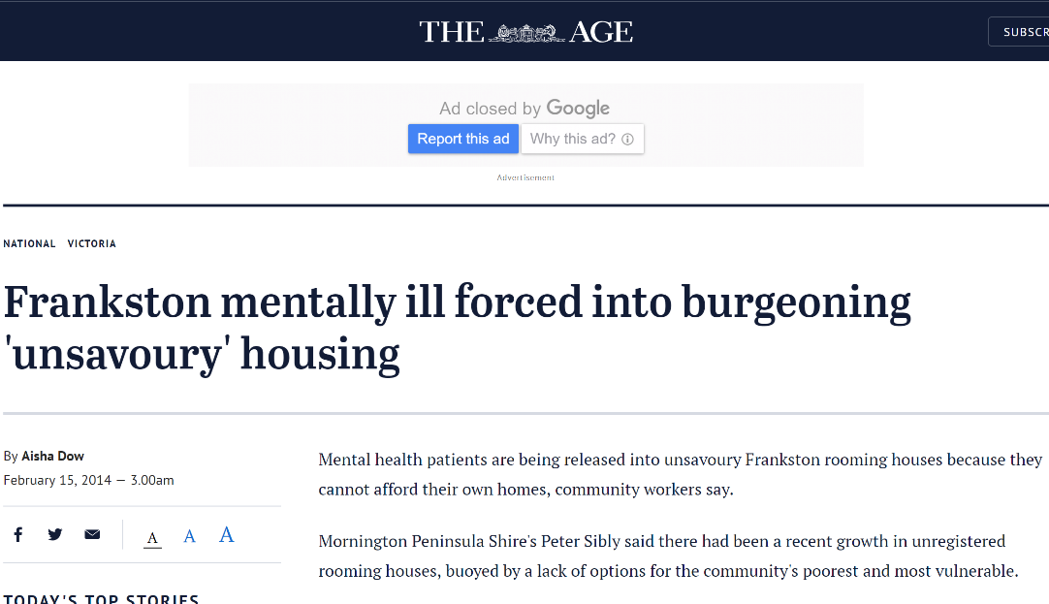
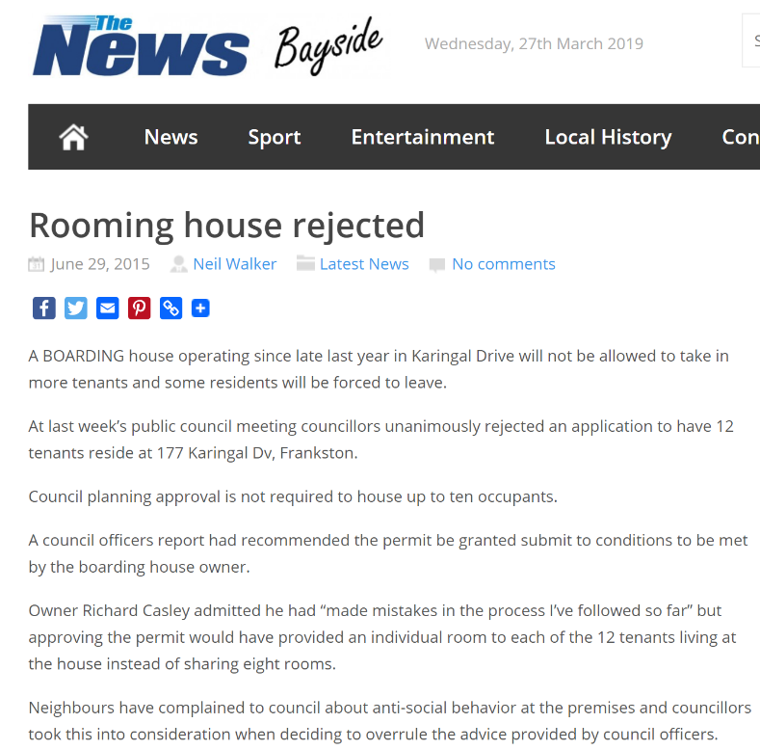
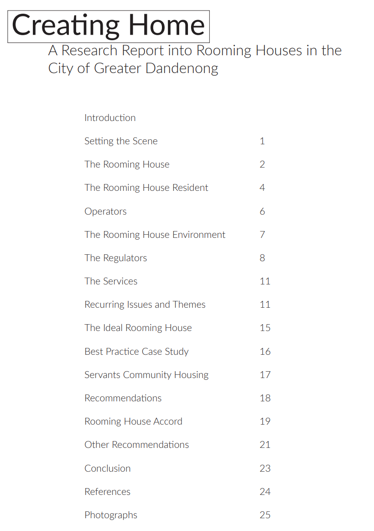

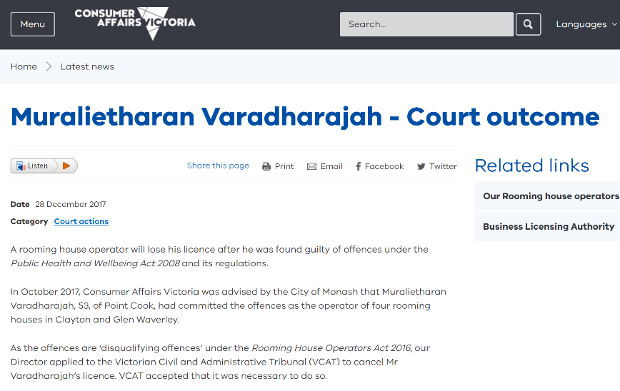


We know what the problem is….

Slide 3
What we’re up to…
Housing Options Worker
Interface
Demand more
Fix relationships
Draw lines

Slide 4
What we’re up to
Working Agreement
Rooming House Provider Working Agreement
Launch has funds to help with payments for accommodation at registered rooming houses
Launch endeavours to pay within 14 days of receiving invoice
Invoices can be sent to hefadmin@launchhousing.org.au
Launch cannot fund if tenants are moved to addresses other than those agreed to at time of booking
Use of a Rooming House Residency Agreement or equivalent is suggested
Launch cannot fund bonds or security deposits. Launch expects that if a bond is charged, it will be lodged with the RTBA
Launch expects tenants to receive receipts for all rental payments
Should a prospective tenant inspect a room, and promptly decide not to stay, no cost will be incurred to the prospective tenant or to Launch
Should a tenant stay less than 48 hours, and notify both Launch and the Landlord of their departure, Launch agrees to be invoiced for 50% of the agreed booking cost only, to cover cleaning and re letting costs. It is expected that invoices will be amended to reflect this.
Launch does not generally help financially with arrears in rooming houses, and expects providers and tenants to arrange repayment plans
If a tenancy is at risk of eviction, the tenant should contact Launch
Launch does not generally provide ongoing support to tenants in rooming houses
Tenancy issues in the first instance should be resolved between tenant and landlord how can seek advice from Tenants Victoria on 9416 2577
Launch’s dedicated Housing Options worker is available 9-5, Monday-Wednesday on 85981103 or 0418166052 or Simon.Okely@launchhousing.org.au

Slide 5
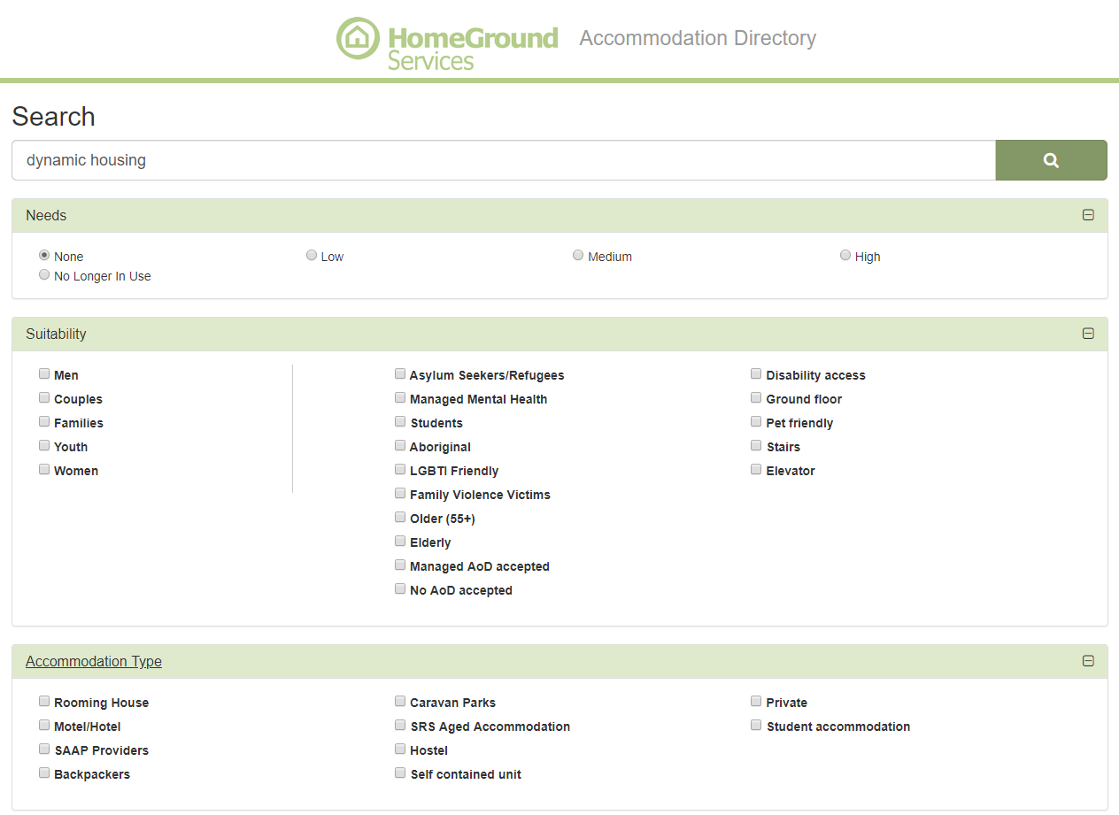
What we’re up to
Accommodation directory

Slide 6
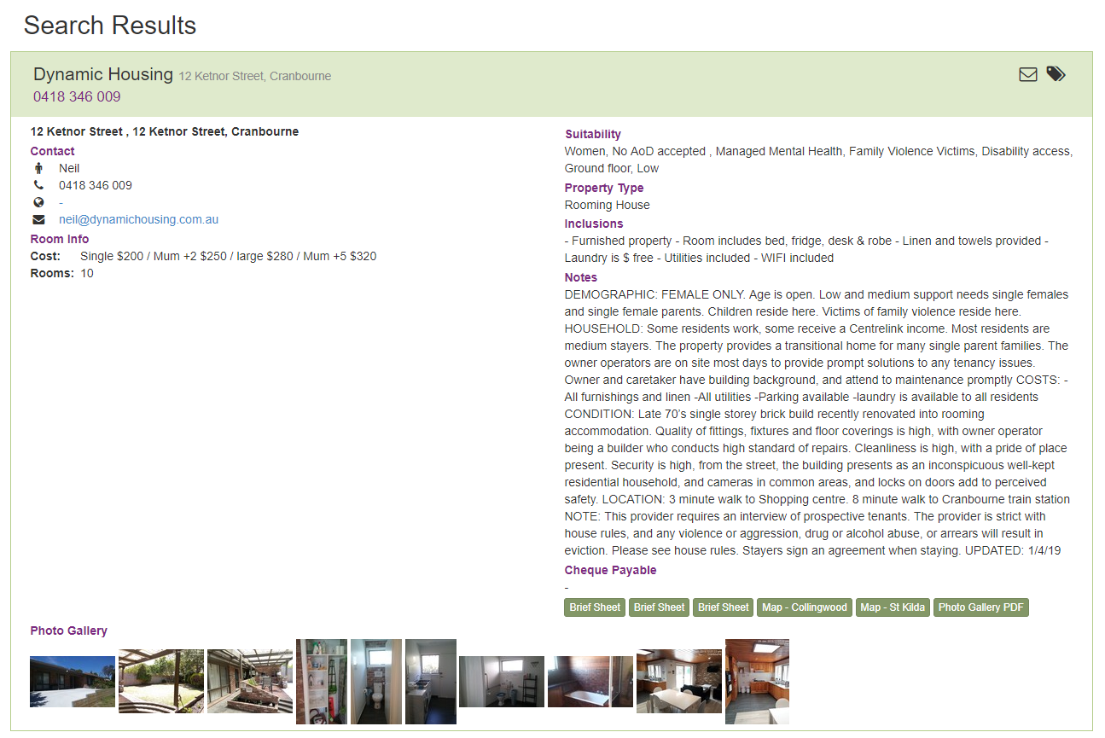
What we’re up to
Accommodation directory

Slide 7
What I reckon
Acknowledge the complexity
Interface
centralise our knowledge and our expectations

